Slide 1
Digital Design & Computer Arch. Lecture 7b: Hardware Description Languages and Verilog
Prof. Onur Mutlu
ETH Zürich
Spring 2020
12 March 2020

Slide 2
Required Readings (This Week)
Hardware Description Languages and Verilog
H&H Chapter 4 in full
Timing and Verification
H&H Chapters 2.9 and 3.5 + (start Chapter 5)
By tomorrow, make sure you are done with
P&P Chapters 1-3 + H&H Chapters 1-4

Slide 3
Required Readings (Next Week)
Von Neumann Model, LC-3, and MIPS
P&P, Chapter 4, 5
H&H, Chapter 6
P&P, Appendices A and C (ISA and microarchitecture of LC-3)
H&H, Appendix B (MIPS instructions)
Programming
P&P, Chapter 6
Recommended: Digital Building Blocks
H&H, Chapter 5

Slide 4
Agenda
Hardware Description Languages
Implementing Combinational Logic (in Verilog)
Implementing Sequential Logic (in Verilog)
The Verilog slides constitute a tutorial. We will not cover all.
All slides will be beneficial for your labs.

Slide 5
Hardware Description Languages & Verilog (Combinational Logic)

Slide 6
2017: Intel Kaby Lake
64-bit processor
4 cores, 8 threads
14-19 stage pipeline
3.9 GHz clock
1.75B transistors
In ~47 years, about 1,000,000-fold growth in transistor count and performance!
https://en.wikichip.org/wiki/intel/microarchitectures/kaby_lake

Slide 7
How to Deal with This Complexity?
Hardware Description Languages!
A fact of life in computer engineering
Need to be able to specify complex designs
communicate with others in your design group
… and to simulate their behavior
yes, it’s what I want to build
… and to synthesize (automatically design) portions of it
have an error-free path to implementation
Hardware Description Languages
Many similarly featured HDLs (e.g., Verilog, VHDL, ...)
if you learn one, it is not hard to learn another
mapping between languages is typically mechanical, especially for the commonly used subset
Notes:
TODO: colorify

Slide 8
Hardware Description Languages
Two well-known hardware description languages
Verilog
Developed in 1984 by Gateway Design Automation
Became an IEEE standard (1364) in 1995
More popular in US
VHDL (VHSIC Hardware Description Language)
Developed in 1981 by the US Department of Defense
Became an IEEE standard (1076) in 1987
More popular in Europe
In this course we will use Verilog

Slide 9
Hardware Design Using Verilog

Slide 10
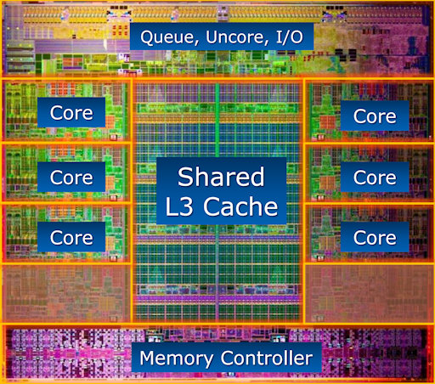

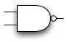
Hierarchical Design
Design hierarchy of modules is built using instantiation
Predefined “primitive” gates (AND, OR, …)
Simple modules are built by instantiating these gates (components like MUXes)
Other modules are built by instantiating simple components, …
Hierarchy controls complexity
Analogous to the use of function abstraction in SW
Complexity is a BIG deal
In real world how big is size of one “blob” of random logic that we would describe as an HDL, then synthesize to gates?
https://techreport.com/review/21987/intel-core-i7-3960x-processor
How many?
Notes:
TODO: ref the picture

Slide 11
Top-Down Design Methodology
We define the top-level module and identify the sub-modules necessary to build the top-level module
Subdivide the sub-modules until we come to leaf cells
Leaf cell: circuit components that cannot further be divided (e.g., logic gates, cell libraries)
Top-level Module
Sub-module
Sub-module
Sub-module
…
…
…
…
Leaf-cell
Leaf-cell
Leaf-cell
Leaf-cell
Notes:
TODO: say that lead-cells are cell libraries that manufacturers have

Slide 12
Bottom-Up Design Methodology
We first identify the building blocks that are available to us
Build bigger modules, using these building blocks
These modules are then used for higher-level modules until we build the top-level module in the design
Top-level Module
Sub-module
Sub-module
Sub-module
…
…
…
…
Leaf-cell
Leaf-cell
Leaf-cell
Leaf-cell

Slide 13
Defining a Module in Verilog
A module is the main building block in Verilog
We first need to define:
Name of the module
Directions of its ports (e.g., input, output)
Names of its ports
Then:
Describe the functionality of the module
example
inputs
output

Slide 14
Implementing a Module in Verilog
example
name of module
Port list
(inputs and outputs)
module example (a, b, c, y);
input a;
input b;
input c;
output y;
// here comes the circuit description
endmodule
ports have a declared type
a module definition

Slide 15
A Question of Style
The following two codes are functionally identical
module test ( a, b, y );
input a;
input b;
output y;
endmodule
module test ( input a,
input b, output y );
endmodule
port name and direction declaration can be combined

Slide 16
What If We Have Multi-bit Input/Output?
You can also define multi-bit Input/Output (Bus)
[range_end : range_start]
Number of bits: range_end – range_start + 1
Example:
a represents a 32-bit value, so we prefer to define it as: [31:0] a
It is preferred over [0:31] a which resembles array definition
It is good practice to be consistent with the representation of multi-bit signals, i.e., always [31:0] or always [0:31]
input [31:0] a; // a[31], a[30] .. a[0]
output [15:8] b1; // b1[15], b1[14] .. b1[8]
output [7:0] b2; // b2[7], b2[6] .. b2[0]
input c; // single signal

Slide 17
Manipulating Bits
Bit Slicing
Concatenation
Duplication
// You can assign partial buses
wire [15:0] longbus;
wire [7:0] shortbus;
assign shortbus = longbus[12:5];
// Concatenating is by {}
assign y = {a[2],a[1],a[0],a[0]};
// Possible to define multiple copies
assign x = {a[0], a[0], a[0], a[0]}
assign y = { 4{a[0]} }

Slide 18
Basic Syntax
Verilog is case sensitive
SomeName and somename are not the same!
Names cannot start with numbers:
2good is not a valid name
Whitespaces are ignored
// Single line comments start with a //
/* Multiline comments
are defined like this */

Slide 19
Two Main Styles of HDL Implementation
Structural (Gate-Level)
The module body contains gate-level description of the circuit
Describe how modules are interconnected
Each module contains other modules (instances)
… and interconnections between these modules
Describes a hierarchy
Behavioral
The module body contains functional description of the circuit
Contains logical and mathematical operators
Level of abstraction is higher than gate-level
Many possible gate-level realizations of a behavioral description
Practical circuits use a combination of both
Notes:
TODO: stick to those rather than dataflow, switch level

Slide 20
Structural (Gate-Level) HDL

Slide 21
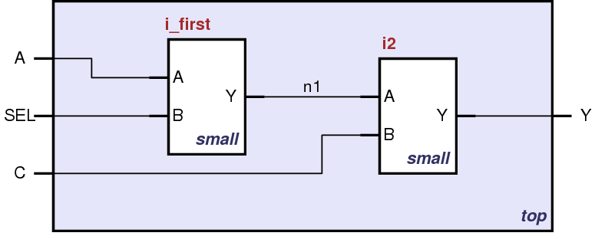
Structural HDL: Instantiating a Module
i_first
i_second
Schematic of module “top” that is built from two instances of module “small”
Notes:
TODO: make I consistent

Slide 22
Structural HDL Example
Module Definitions in Verilog
module top (A, SEL, C, Y);
input A, SEL, C;
output Y;
wire n1;
endmodule
i_first
i_second
module small (A, B, Y);
input A;
input B;
output Y;
// description of small
endmodule

Slide 23
Structural HDL Example
Defining wires (module interconnections)
module top (A, SEL, C, Y);
input A, SEL, C;
output Y;
wire n1;
endmodule
i_first
i_second
module small (A, B, Y);
input A;
input B;
output Y;
// description of small
endmodule

Slide 24
Structural HDL Example
The first instantiation of the “small” module
module top (A, SEL, C, Y);
input A, SEL, C;
output Y;
wire n1;
// instantiate small once
small i_first ( .A(A),
.B(SEL),
.Y(n1) );
endmodule
i_first
i_second
module small (A, B, Y);
input A;
input B;
output Y;
// description of small
endmodule

Slide 25
Structural HDL Example
The second instantiation of the “small” module
module top (A, SEL, C, Y);
input A, SEL, C;
output Y;
wire n1;
// instantiate small once
small i_first ( .A(A),
.B(SEL),
.Y(n1) );
// instantiate small second time
small i_second ( .A(n1),
.B(C),
.Y(Y) );
endmodule
i_first
i_second
module small (A, B, Y);
input A;
input B;
output Y;
// description of small
endmodule

Slide 26
Structural HDL Example
Short form of module instantiation
module top (A, SEL, C, Y);
input A, SEL, C;
output Y;
wire n1;
// alternative
small i_first ( A, SEL, n1 );
/* Shorter instantiation,
pin order very important */
// any pin order, safer choice
small i_second ( .B(C),
.Y(Y),
.A(n1) );
endmodule
i_first
i_second
module small (A, B, Y);
input A;
input B;
output Y;
// description of small
endmodule
Short form is not good practice
as it reduces code maintainability

Slide 27
Structural HDL Example 2
Verilog supports basic logic gates as predefined primitives
These primitives are instantiated like modules except that they are predefined in Verilog and do not need a module definition
module mux2(input d0, d1,
input s,
output y);
wire ns, y1, y2;
not g1 (ns, s);
and g2 (y1, d0, ns);
and g3 (y2, d1, s);
or g4 (y, y1, y2);
endmodule

Slide 28
Behavioral HDL

Slide 29
Recall: Two Main Styles of HDL Implementation
Structural (Gate-Level)
The module body contains gate-level description of the circuit
Describe how modules are interconnected
Each module contains other modules (instances)
… and interconnections between these modules
Describes a hierarchy
Behavioral
The module body contains functional description of the circuit
Contains logical and mathematical operators
Level of abstraction is higher than gate-level
Many possible gate-level realizations of a behavioral description
Practical circuits would use a combination of both
Notes:
TODO: stick to those rather than dataflow, switch level

Slide 30
Behavioral HDL: Defining Functionality
module example (a, b, c, y);
input a;
input b;
input c;
output y;
// here comes the circuit description
assign y = ~a & ~b & ~c |
a & ~b & ~c |
a & ~b & c;
endmodule

Slide 31
Behavioral HDL: Schematic View
A behavioral implementation still models a hardware circuit!
AND
a
AND
OR
y
b
AND
c

Slide 32
Bitwise Operators in Behavioral Verilog
module gates(input [3:0] a, b,
output [3:0] y1, y2, y3, y4, y5);
/* Five different two-input logic
gates acting on 4 bit buses */
assign y1 = a & b; // AND
assign y2 = a | b; // OR
assign y3 = a ^ b; // XOR
assign y4 = ~(a & b); // NAND
assign y5 = ~(a | b); // NOR
endmodule

Slide 33
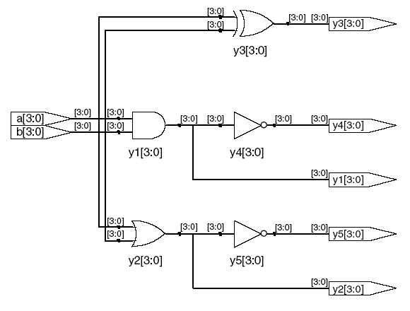
Bitwise Operators: Schematic View

Slide 34
Reduction Operators in Behavioral Verilog
module and8(input [7:0] a,
output y);
assign y = &a;
// &a is much easier to write than
// assign y = a[7] & a[6] & a[5] & a[4] &
// a[3] & a[2] & a[1] & a[0];
endmodule

Slide 35
Reduction Operators: Schematic View
[0]
[1]
[2]
AND
[3]
[7:0]
a[7:0]
[4]
y
[5]
[6]
[7]
8-input AND gate
Notes:
TODO: fix the y in the bottom

Slide 36
Conditional Assignment in Behavioral Verilog
module mux2(input [3:0] d0, d1,
input s,
output [3:0] y);
assign y = s ? d1 : d0;
// if (s) then y=d1 else y=d0;
endmodule
? : is also called a ternary operator as it operates on three inputs:
s
d1
d0

Slide 37
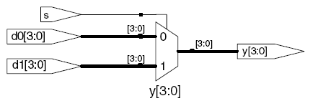
Conditional Assignment: Schematic View

Slide 38
More Complex Conditional Assignments
module mux4(input [3:0] d0, d1, d2, d3
input [1:0] s,
output [3:0] y);
assign y = s[1] ? ( s[0] ? d3 : d2)
: ( s[0] ? d1 : d0);
// if (s1) then
// if (s0) then y=d3 else y=d2
// else
// if (s0) then y=d1 else y=d0
endmodule

Slide 39
Even More Complex Conditional Assignments
module mux4(input [3:0] d0, d1, d2, d3
input [1:0] s,
output [3:0] y);
assign y = (s == 2’b11) ? d3 :
(s == 2’b10) ? d2 :
(s == 2’b01) ? d1 :
d0;
// if (s = “11” ) then y= d3
// else if (s = “10” ) then y= d2
// else if (s = “01” ) then y= d1 // else y= d0
endmodule

Slide 40
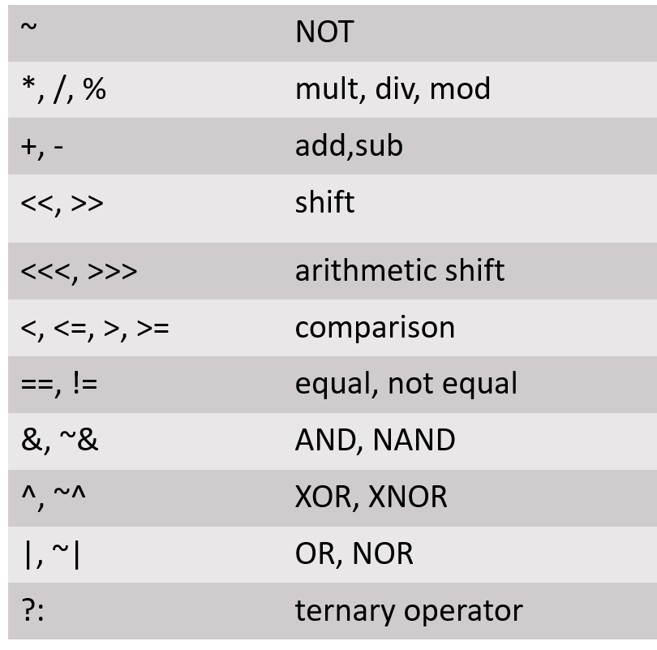
Precedence of Operations in Verilog
Highest
Lowest

Slide 41
How to Express Numbers ?
N’Bxx
8’b0000_0001
(N) Number of bits
Expresses how many bits will be used to store the value
(B) Base
Can be b (binary), h (hexadecimal), d (decimal), o (octal)
(xx) Number
The value expressed in base
Can also have X (invalid) and Z (floating), as values
Underscore _ can be used to improve readability

Slide 42
Number Representation in Verilog
Verilog | Stored Number | Verilog | Stored Number
4’b1001 | 1001 | 4’d5 | 0101
8’b1001 | 0000 1001 | 12’hFA3 | 1111 1010 0011
8’b0000_1001 | 0000 1001 | 8’o12 | 00 001 010
8’bxX0X1zZ1 | XX0X 1ZZ1 | 4’h7 | 0111
‘b01 | 0000 .. 0001 | 12’h0 | 0000 0000 0000
32 bits (default)

Slide 43
Reminder: Floating Signals (Z)
Floating signal: Signal that is not driven by any circuit
Open circuit, floating wire
Also known as: high impedance, hi-Z, tri-stated signals
module tristate_buffer(input [3:0] a,
input en,
output [3:0] y);
assign y = en ? a : 4'bz;
endmodule

Slide 44
Recall: Tri-State Buffer
A tri-state buffer enables gating of different signals onto a wire

Slide 45
Recall: Example Use of Tri-State Buffers
Imagine a wire connecting the CPU and memory
At any time only the CPU or the memory can place a value on the wire, both not both
You can have two tri-state buffers: one driven by CPU, the other memory; and ensure at most one is enabled at any time

Slide 46
Recall: Example Design with Tri-State Buffers
GateCPU
CPU
GateMem
Memory
Shared Bus

Slide 47
Truth Table for AND with Z and X
AND |  | A
 |  | 0 | 1 | Z | X
B | 0 | 0 | 0 | 0 | 0
 | 1 | 0 | 1 | X | X
 | Z | 0 | X | X | X
 | X | 0 | X | X | X

Slide 48
What Happens with HDL Code?
Synthesis
Modern tools are able to map synthesizable HDL code into low-level cell libraries → netlist describing gates and wires
They can perform many optimizations
… however they can not guarantee that a solution is optimal
Mainly due to computationally expensive placement and routing algorithms
Most common way of Digital Design these days
Simulation
Allows the behavior of the circuit to be verified without actually manufacturing the circuit
Simulators can work on structural or behavioral HDL
Notes:
Todo: use color

Slide 49
Recall This “example”
module example (a, b, c, y);
input a;
input b;
input c;
output y;
// here comes the circuit description
assign y = ~a & ~b & ~c |
a & ~b & ~c |
a & ~b & c;
endmodule

Slide 50
Synthesizing the “example”
AND
a
AND
OR
y
b
AND
c

Slide 51
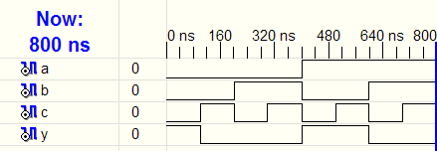
Simulating the “example”
AND
a
AND
OR
y
b
AND
c
1
signals
1
1
0
Waveform Diagram
time

Slide 52
What We Have Seen So Far
Describing structural hierarchy with Verilog
Instantiate modules in an other module
Describing functionality using behavioral modeling
Writing simple logic equations
We can write AND, OR, XOR, …
Multiplexer functionality
If … then … else
We can describe constants
But there is more...

Slide 53
More Verilog Examples
We can write Verilog code in many different ways
Let’s see how we can express the same functionality by developing Verilog code
At low-level
Poor readability
More optimization opportunities (especially for low-level tools)
At a higher-level of abstraction
Better readability
Limited optimization opportunities

Slide 54
Comparing Two Numbers
Defining your own gates as new modules
We will use our gates to show the different ways of implementing a 4-bit comparator (equality checker)
An XNOR gate
An AND gate
module MyXnor (input A, B,
output Z);
assign Z = ~(A ^ B); //not XOR
endmodule
module MyAnd (input A, B,
output Z);
assign Z = A & B; // AND
endmodule

Slide 55
Gate-Level Implementation
module compare (input a0, a1, a2, a3, b0, b1, b2, b3,
output eq);
wire c0, c1, c2, c3, c01, c23;
MyXnor i0 (.A(a0), .B(b0), .Z(c0) ); // XNOR
MyXnor i1 (.A(a1), .B(b1), .Z(c1) ); // XNOR
MyXnor i2 (.A(a2), .B(b2), .Z(c2) ); // XNOR
MyXnor i3 (.A(a3), .B(b3), .Z(c3) ); // XNOR
MyAnd haha (.A(c0), .B(c1), .Z(c01) ); // AND
MyAnd hoho (.A(c2), .B(c3), .Z(c23) ); // AND
MyAnd bubu (.A(c01), .B(c23), .Z(eq) ); // AND
endmodule

Slide 56
Using Logical Operators
module compare (input a0, a1, a2, a3, b0, b1, b2, b3,
output eq);
wire c0, c1, c2, c3, c01, c23;
MyXnor i0 (.A(a0), .B(b0), .Z(c0) ); // XNOR
MyXnor i1 (.A(a1), .B(b1), .Z(c1) ); // XNOR
MyXnor i2 (.A(a2), .B(b2), .Z(c2) ); // XNOR
MyXnor i3 (.A(a3), .B(b3), .Z(c3) ); // XNOR
assign c01 = c0 & c1;
assign c23 = c2 & c3;
assign eq = c01 & c23;
endmodule

Slide 57
Eliminating Intermediate Signals
module compare (input a0, a1, a2, a3, b0, b1, b2, b3,
output eq);
wire c0, c1, c2, c3;
MyXnor i0 (.A(a0), .B(b0), .Z(c0) ); // XNOR
MyXnor i1 (.A(a1), .B(b1), .Z(c1) ); // XNOR
MyXnor i2 (.A(a2), .B(b2), .Z(c2) ); // XNOR
MyXnor i3 (.A(a3), .B(b3), .Z(c3) ); // XNOR
// assign c01 = c0 & c1;
// assign c23 = c2 & c3;
// assign eq = c01 & c23;
assign eq = c0 & c1 & c2 & c3;
endmodule

Slide 58
Multi-Bit Signals (Bus)
module compare (input [3:0] a, input [3:0] b,
output eq);
wire [3:0] c; // bus definition
MyXnor i0 (.A(a[0]), .B(b[0]), .Z(c[0]) ); // XNOR
MyXnor i1 (.A(a[1]), .B(b[1]), .Z(c[1]) ); // XNOR
MyXnor i2 (.A(a[2]), .B(b[2]), .Z(c[2]) ); // XNOR
MyXnor i3 (.A(a[3]), .B(b[3]), .Z(c[3]) ); // XNOR
assign eq = &c; // short format
endmodule

Slide 59
Bitwise Operations
module compare (input [3:0] a, input [3:0] b,
output eq);
wire [3:0] c; // bus definition
// MyXnor i0 (.A(a[0]), .B(b[0]), .Z(c[0]) );
// MyXnor i1 (.A(a[1]), .B(b[1]), .Z(c[1]) );
// MyXnor i2 (.A(a[2]), .B(b[2]), .Z(c[2]) );
// MyXnor i3 (.A(a[3]), .B(b[3]), .Z(c[3]) );
assign c = ~(a ^ b); // XNOR
assign eq = &c; // short format
endmodule

Slide 60
Highest Abstraction Level: Comparing Two Numbers
module compare (input [3:0] a, input [3:0] b,
output eq);
// assign c = ~(a ^ b); // XNOR
// assign eq = &c; // short format
assign eq = (a == b) ? 1 : 0; // really short
endmodule

Slide 61
Writing More Reusable Verilog Code
We have a module that can compare two 4-bit numbers
What if in the overall design we need to compare:
5-bit numbers?
6-bit numbers?
…
N-bit numbers?
Writing code for each case looks tedious
What could be a better way?

Slide 62
Parameterized Modules
In Verilog, we can define module parameters
module mux2
#(parameter width = 8) // name and default value
(input [width-1:0] d0, d1,
input s,
output [width-1:0] y);
assign y = s ? d1 : d0;
endmodule
We can set the parameters to different values
when instantiating the module

Slide 63
Instantiating Parameterized Modules
module mux2
#(parameter width = 8) // name and default value
(input [width-1:0] d0, d1,
input s,
output [width-1:0] y);
assign y = s ? d1 : d0;
endmodule
// If the parameter is not given, the default (8) is assumed
mux2 i_mux (d0, d1, s, out);
// The same module with 12-bit bus width:
mux2 #(12) i_mux_b (d0, d1, s, out);
// A more verbose version:
mux2 #(.width(12)) i_mux_b (.d0(d0), .d1(d1),
.s(s), .out(out));

Slide 64
What Is the BEST Way of Writing Verilog
Quite simply IT DOES NOT EXIST!
Code should be easy to understand
Sometimes longer code is easier to comprehend
Hierarchy is very useful
In the previous example it did not look like that, but for larger designs it is indispensable
Try to stay closer to hardware
After all the goal is to design hardware

Slide 65
What About Timing?
It is possible to define timing relations in Verilog. BUT:
These are ONLY for simulation
They CAN NOT be synthesized
They are used for modeling delays in a circuit
‘timescale 1ns/1ps
module simple (input a, output z1, z2);
assign #5 z1 = ~a; // inverted output after 5ns
assign #9 z2 = a; // output after 9ns
endmodule
More to come later today!

Slide 66
Good Practices
Develop/use a consistent naming style
Use MSB to LSB ordering for buses
Use “a[31:0]”, not “a[0:31]”
Define one module per file
Makes managing your design hierarchy easier
Use a file name that equals module name
e.g., module TryThis is defined in a file called TryThis.v
Always keep in mind that Verilog describes hardware

Slide 67
Summary (HDL for Combinational Logic)
We have seen an overview of Verilog
Discussed structural and behavioral modeling
Showed combinational logic constructs

Slide 68
Implementing Sequential Logic Using Verilog

Slide 69
Combinational + Memory = Sequential
Sequential Circuit
inputs
Combinational
Circuit
outputs
Storage
Element

Slide 70
Sequential Logic in Verilog
Define blocks that have memory
Flip-Flops, Latches, Finite State Machines
Sequential Logic state transition is triggered by a “CLOCK” signal
Latches are sensitive to level of the signal
Flip-flops are sensitive to the transitioning of signal
Combinational constructs are not sufficient
We need new constructs:
always
posedge/negedge

Slide 71
The “always” Block
always @ (sensitivity list)
statement;
Whenever the event in the sensitivity list occurs,
the statement is executed

Slide 72
Example: D Flip-Flop
module flop(input clk,
input [3:0] d,
output reg [3:0] q);
always @ (posedge clk)
q <= d; // pronounced “q gets d”
endmodule
posedge defines a rising edge (transition from 0 to 1).
Statement executed when the clk signal rises (posedge of clk)
Once the clk signal rises: the value of d is copied to q

Slide 73
Example: D Flip-Flop
module flop(input clk,
input [3:0] d,
output reg [3:0] q);
always @ (posedge clk)
q <= d; // pronounced “q gets d”
endmodule
assign statement is not used within an always block
<= describes a non-blocking assignment
We will see the difference between blocking assignment and non-blocking assignment soon

Slide 74
Example: D Flip-Flop
module flop(input clk,
input [3:0] d,
output reg [3:0] q);
always @ (posedge clk)
q <= d; // pronounced “q gets d”
endmodule
Assigned variables need to be declared as reg
The name reg does not necessarily mean that the value is a register (It could be, but it does not have to be)
We will see examples later

Slide 75
Asynchronous and Synchronous Reset
Reset signals are used to initialize the hardware to a known state
Usually activated at system start (on power up)
Asynchronous Reset
The reset signal is sampled independent of the clock
Reset gets the highest priority
Sensitive to glitches, may have metastability issues
Will be discussed in Lecture 8
Synchronous Reset
The reset signal is sampled with respect to the clock
The reset should be active long enough to get sampled at the clock edge
Results in completely synchronous circuit

Slide 76
D Flip-Flop with Asynchronous Reset
module flop_ar (input clk,
input reset,
input [3:0] d,
output reg [3:0] q);
always @ (posedge clk, negedge reset)
begin
if (reset == 0) q <= 0; // when reset
else q <= d; // when clk
end
endmodule
In this example: two events can trigger the process:
A rising edge on clk
A falling edge on reset

Slide 77
D Flip-Flop with Asynchronous Reset
module flop_ar (input clk,
input reset,
input [3:0] d,
output reg [3:0] q);
always @ (posedge clk, negedge reset)
begin
if (reset == 0) q <= 0; // when reset
else q <= d; // when clk
end
endmodule
For longer statements, a begin-end pair can be used
To improve readability
In this example, it was not necessary, but it is a good idea

Slide 78
D Flip-Flop with Asynchronous Reset
module flop_ar (input clk,
input reset,
input [3:0] d,
output reg [3:0] q);
always @ (posedge clk, negedge reset)
begin
if (reset == 0) q <= 0; // when reset
else q <= d; // when clk
end
endmodule
First reset is checked: if reset is 0, q is set to 0.
This is an asynchronous reset as the reset can happen independently of the clock (on the negative edge of reset signal)
If there is no reset, then regular assignment takes effect

Slide 79
D Flip-Flop with Synchronous Reset
module flop_sr (input clk,
input reset,
input [3:0] d,
output reg [3:0] q);
always @ (posedge clk)
begin
if (reset == ‘0’) q <= 0; // when reset
else q <= d; // when clk
end
endmodule
The process is sensitive to only clock
Reset happens only when the clock rises. This is a synchronous reset

Slide 80
D Flip-Flop with Enable and Reset
module flop_en_ar (input clk,
input reset,
input en,
input [3:0] d,
output reg [3:0] q);
always @ (posedge clk, negedge reset)
begin
if (reset == ‘0’) q <= 0; // when reset
else if (en) q <= d; // when en AND clk
end
endmodule
A flip-flop with enable and reset
Note that the en signal is not in the sensitivity list
q gets d only when clk is rising and en is 1

Slide 81
Example: D Latch
module latch (input clk,
input [3:0] d,
output reg [3:0] q);
always @ (clk, d)
if (clk) q <= d; // latch is transparent when
// clock is 1
endmodule

Slide 82
Summary: Sequential Statements So Far
Sequential statements are within an always block
The sequential block is triggered with a change in the sensitivity list
Signals assigned within an always must be declared as reg
We use <= for (non-blocking) assignments and do not use assign within the always block.

Slide 83
Basics of always Blocks
module example (input clk,
input [3:0] d,
output reg [3:0] q);
wire [3:0] normal; // standard wire
reg [3:0] special; // assigned in always
always @ (posedge clk)
special <= d; // first FF array
assign normal = ~ special; // simple assignment
always @ (posedge clk)
q <= normal; // second FF array
endmodule
You can have as many always blocks as needed
Assignment to the same signal in different always blocks is not allowed!

Slide 84
Why Does an always Block Remember?
module flop (input clk,
input [3:0] d,
output reg [3:0] q);
always @ (posedge clk)
begin
q <= d; // when clk rises copy d to q
end
endmodule
This statement describes what happens to signal q
… but what happens when the clock is not rising?
The value of q is preserved (remembered)

Slide 85
An always Block Does NOT Always Remember
module comb (input inv,
input [3:0] data,
output reg [3:0] result);
always @ (inv, data) // trigger with inv, data
if (inv) result <= ~data;// result is inverted data
else result <= data; // result is data
endmodule
This statement describes what happens to signal result
When inv is 1, result is ~data
When inv is not 1, result is data
The circuit is combinational (no memory)
result is assigned a value in all cases of the if .. else block, always

Slide 86
always Blocks for Combinational Circuits
An always block defines combinational logic if:
All outputs are always (continuously) updated
1. All right-hand side signals are in the sensitivity list
You can use always @* for short
2. All left-hand side signals get assigned in every possible condition of if .. else and case blocks
It is easy to make mistakes and unintentionally describe memorizing elements (latches)
Vivado will most likely warn you. Make sure you check the warning messages
Always blocks allow powerful combinational logic statements
if .. else
case

Slide 87
Sequential or Combinational?
wire enable, data;
reg out_a, out_b;
always @ (*) begin
out_a = 1’b0;
if(enable) begin
out_a = data;
out_b = data;
end
end
wire enable, data;
reg out_a, out_b;
always @ (data) begin
out_a = 1’b0;
out_b = 1’b0;
if(enable) begin
out_a = data;
out_b = data;
end
end
No assignment for ~enable
Not in the sensitivity list
Sequential
Sequential

Slide 88
The always Block is NOT Always Practical/Nice
reg [31:0] result;
wire [31:0] a, b, comb;
wire sel,
always @ (a, b, sel) // trigger with a, b, sel
if (sel) result <= a; // result is a
else result <= b; // result is b
assign comb = sel ? a : b;
Both statements describe the same multiplexer
In this case, the always block is more work

Slide 89
always Block for Case Statements (Handy!)
module sevensegment (input [3:0] data,
output reg [6:0] segments);
always @ ( * ) // * is short for all signals
case (data) // case statement
4'd0: segments = 7'b111_1110; // when data is 0
4'd1: segments = 7'b011_0000; // when data is 1
4'd2: segments = 7'b110_1101;
4'd3: segments = 7'b111_1001;
4'd4: segments = 7'b011_0011;
4'd5: segments = 7'b101_1011;
// etc etc
default: segments = 7'b000_0000; // required
endcase
endmodule

Slide 90
Summary: always Block
if .. else can only be used in always blocks
The always block is combinational only if all regs within the block are always assigned to a signal
Use the default case to make sure you do not forget an unimplemented case, which may otherwise result in a latch
Use casex statement to be able to check for don’t cares

Slide 91
Non-Blocking and Blocking Assignments
Non-blocking (<=)
Blocking (=)
always @ (a)
begin
a <= 2’b01;
b <= a;
// all assignments are made here
// b is not (yet) 2’b01
end
always @ (a)
begin
a = 2’b01;
// a is 2’b01
b = a;
// b is now 2’b01 as well
end
All assignments are made at the end of the block
All assignments are made in parallel, process flow is not-blocked
Each assignment is made immediately
Process waits until the first assignment is complete, it blocks progress

Slide 92
Why use (Non)-Blocking Statements
There are technical reasons why both are required
It is out of the scope of this course to discuss these
Blocking statements allow sequential descriptions
More like a programming language
If the sensitivity list is correct, blocks with non-blocking statements will always evaluate to the same result
This may require some additional iterations

Slide 93
Example: Blocking Assignment
Assume all inputs are initially ‘0’
always @ ( * )
begin
p = a ^ b ; // p = 0
g = a & b ; // g = 0
s = p ^ cin ; // s = 0
cout = g | (p & cin) ; // cout = 0
end
1
0
1
0
If a changes to ‘1’
All values are updated in order

Slide 94
The Same Example: Non-Blocking Assignment
Assume all inputs are initially ‘0’
always @ ( * )
begin
p <= a ^ b ; // p = 0
g <= a & b ; // g = 0
s <= p ^ cin ; // s = 0
cout <= g | (p & cin) ; // cout = 0
end
1
0
0
0
If a changes to ‘1’
All assignments are concurrent
When s is being assigned, p is still 0

Slide 95
The Same Example: Non-Blocking Assignment
After the first iteration, p has changed to ‘1’ as well
always @ ( * )
begin
p <= a ^ b ; // p = 1
g <= a & b ; // g = 0
s <= p ^ cin ; // s = 0
cout <= g | (p & cin) ; // cout = 0
end
1
0
1
0
Since there is a change in p, the process triggers again
This time s is calculated with p=1

Slide 96
Rules for Signal Assignment
Use always @(posedge clk) and non-blocking assignments (<=) to model synchronous sequential logic
Use continuous assignments (assign) to model simple combinational logic.
always @ (posedge clk)
q <= d; // non-blocking
assign y = a & b;

Slide 97
Rules for Signal Assignment (Cont.)
Use always @ (*) and blocking assignments (=) to model more complicated combinational logic.
You cannot make assignments to the same signal in more than one always block or in a continuous assignment
always @ (*)
a = b;
always @ (*)
a = c;
always @ (*)
a = b;
assign a = c;

Slide 98
Recall: Finite State Machines (FSMs)
Each FSM consists of three separate parts:
next state logic
state register
output logic
state register

Slide 99
Recall: Finite State Machines (FSMs) Comprise
Sequential circuits
State register(s)
Store the current state and
Load the next state at the clock edge
Combinational Circuits
Next state logic
Determines what the next state will be
Output logic
Generates the outputs
Notes:
discuss DFlipFlop here. Latch doesn't do this, so we need sequential circuit that stores state and loads next state at the clock edge. next state is available for the full clock cycle
now lets take a look at this.

Slide 100
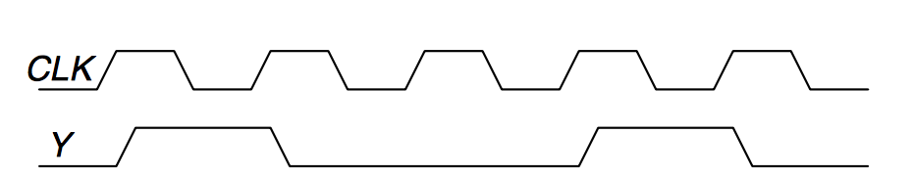
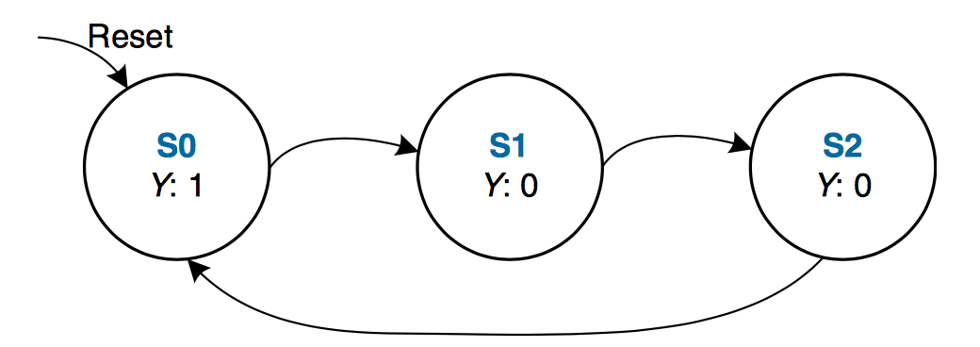
FSM Example 1: Divide the Clock Frequency by 3
The output Y is HIGH for one clock cycle out of every 3. In other words, the output divides the frequency of the clock by 3.

Slide 101
Implementing FSM Example 1: Definitions
module divideby3FSM (input clk,
input reset,
output q);
reg [1:0] state, nextstate;
parameter S0 = 2'b00;
parameter S1 = 2'b01;
parameter S2 = 2'b10;
We define state and nextstate as 2-bit reg
The parameter descriptions are optional, it makes reading easier

Slide 102
Implementing FSM Example 1: State Register
// state register
always @ (posedge clk, posedge reset)
if (reset) state <= S0;
else state <= nextstate;
This part defines the state register (memorizing process)
Sensitive to only clk, reset
In this example, reset is active when it is ‘1’ (active-high)

Slide 103
Implementing FSM Example 1: Next State Logic
// next state logic
always @ (*)
case (state)
S0: nextstate = S1;
S1: nextstate = S2;
S2: nextstate = S0;
default: nextstate = S0;
endcase

Slide 104
Implementing FSM Example 1: Output Logic
// output logic
assign q = (state == S0);
In this example, output depends only on state
Moore type FSM

Slide 105
Implementation of FSM Example 1
module divideby3FSM (input clk, input reset, output q);
reg [1:0] state, nextstate;
parameter S0 = 2'b00; parameter S1 = 2'b01; parameter S2 = 2'b10;
always @ (posedge clk, posedge reset) // state register
if (reset) state <= S0;
else state <= nextstate;
always @ (*) // next state logic
case (state)
S0: nextstate = S1;
S1: nextstate = S2;
S2: nextstate = S0;
default: nextstate = S0;
endcase
assign q = (state == S0); // output logic
endmodule

Slide 106
Digital Design & Computer Arch. Lecture 7b: Hardware Description Languages and Verilog
Prof. Onur Mutlu
ETH Zürich
Spring 2020
12 March 2020

Slide 107
We did not cover the following. They are for your preparation.

Slide 108
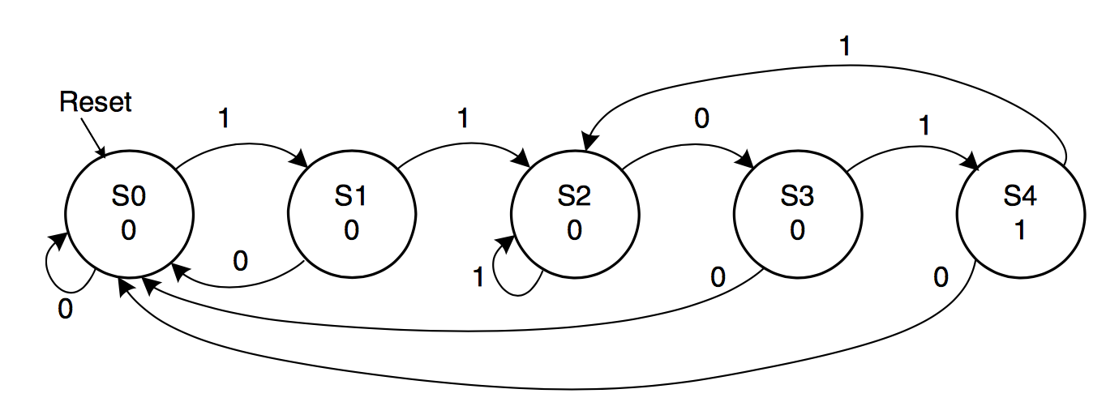
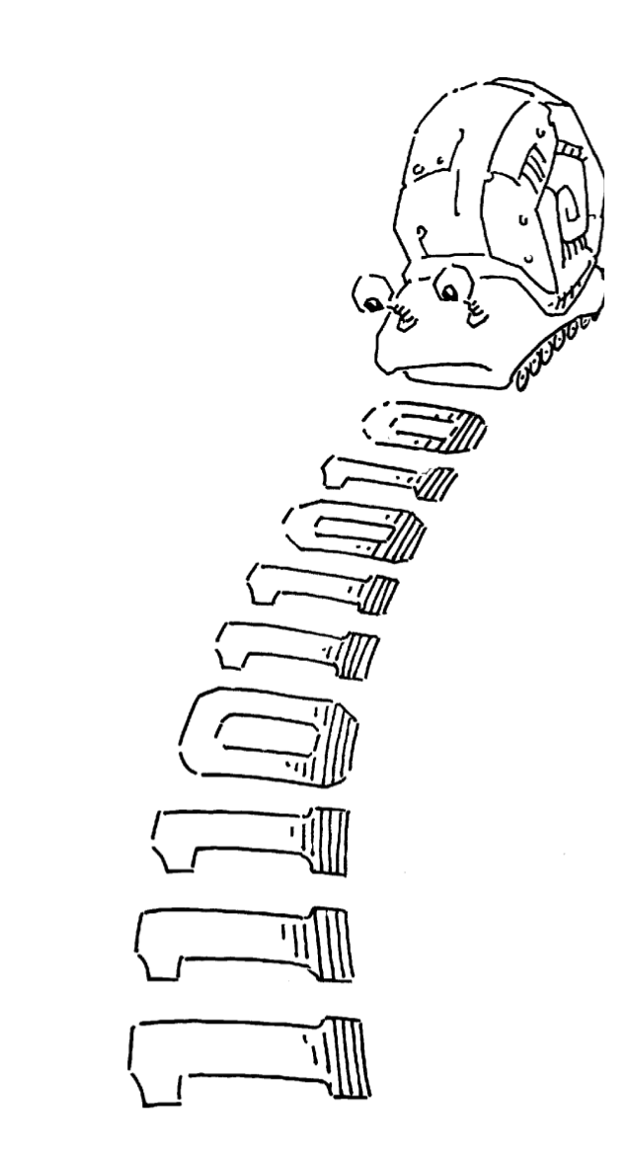
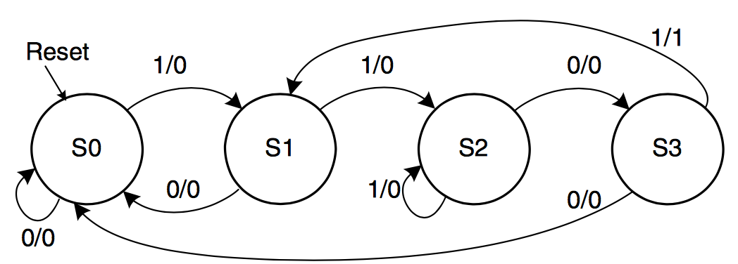
FSM Example 2: Smiling Snail
Alyssa P. Hacker has a snail that crawls down a paper tape with 1’s and 0’s on it.
The snail smiles whenever the last four digits it has crawled over are 1101.
Design Moore and Mealy FSMs of the snail’s brain.
Moore
Mealy

Slide 109
Implementing FSM Example 2: Definitions
module SmilingSnail (input clk,
input reset,
input number,
output smile);
reg [1:0] state, nextstate;
parameter S0 = 2'b00;
parameter S1 = 2'b01;
parameter S2 = 2'b10;
parameter S3 = 2’b11;
number/smile

Slide 110
Implementing FSM Example 2: State Register
// state register
always @ (posedge clk, posedge reset)
if (reset) state <= S0;
else state <= nextstate;
This part defines the state register (memorizing process)
Sensitive to only clk, reset
In this example reset is active when ‘1’ (active-high)

Slide 111
Implementing FSM Example 2: Next State Logic
// next state logic
always @ (*)
case (state)
S0: if (number) nextstate = S1;
else nextstate = S0;
S1: if (number) nextstate = S2;
else nextstate = S0;
S2: if (number) nextstate = S2;
else nextstate = S3;
S3: if (number) nextstate = S1;
else nextstate = S0;
default: nextstate = S0;
endcase

Slide 112
Implementing FSM Example 2: Output Logic
// output logic
assign smile = (number & state == S3);
In this example, output depends on state and input
Mealy type FSM
We used a simple combinational assignment

Slide 113
Implementation of FSM Example 2
module SmilingSnail (input clk,
input reset,
input number,
output smile);
reg [1:0] state, nextstate;
parameter S0 = 2'b00;
parameter S1 = 2'b01;
parameter S2 = 2'b10;
parameter S3 = 2’b11;
// state register
always @ (posedge clk, posedge reset)
if (reset) state <= S0;
else state <= nextstate;
always @ (*) // next state logic
case (state)
S0: if (number)
nextstate = S1;
else nextstate = S0;
S1: if (number)
nextstate = S2;
else nextstate = S0;
S2: if (number)
nextstate = S2;
else nextstate = S3;
S3: if (number)
nextstate = S1;
else nextstate = S0;
default: nextstate = S0;
endcase
// output logic
assign smile = (number & state==S3);
endmodule

Slide 114
What Did We Learn?
Basics of defining sequential circuits in Verilog
The always statement
Needed for defining memorizing elements (flip-flops, latches)
Can also be used to define combinational circuits
Blocking vs Non-blocking statements
= assigns the value immediately
<= assigns the value at the end of the block
Writing FSMs
Next state logic
State assignment
Output logic

Slide 115
Next Lecture: Timing and Verification

